Slide 1



Cloud: Kubernetes Audience: All

Slide 2
Introduction
Cloud: Kubernetes
Who I am: <Instructor Name>
Title
Organization
Role
Background

Slide 3
Agenda
Cloud: Kubernetes
Microservices – History, Driving Forces, and Definition
Microservices Patterns
DevOps
Reactive Microservices
1
5
9
13
AD
All
D
AD
A
Microservices Prerequisites
Integration
Securing Microservices
Testing
2
6
10
14
AD
AD
A
D
A
A
Spring Boot
Migrating Monoliths to Microservices
Domain Driven Design Testing
Scaling Microservices
3
7
11
15
AD
D
A
A
A
Case Study
Cloud
UI
Microservices Anti-Patterns
4
8
12
16
AD
AD
All
All
A
A
Legend: All Developer Advanced Developer Architect
All
D
AD
A

Slide 4

Objectives
Cloud: Kubernetes
At the end of this training, you should be able to understand the following:
Kubernetes

Slide 5
Topics
Cloud: Kubernetes
Kubernetes

Slide 6
<>

Slide 7
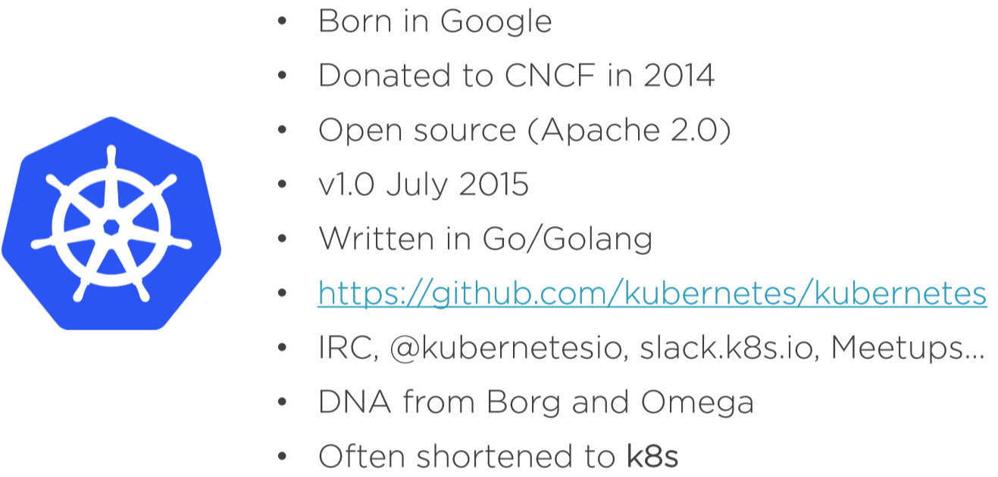
History
To SME: Need a title.
Cloud: Kubernetes

Slide 8
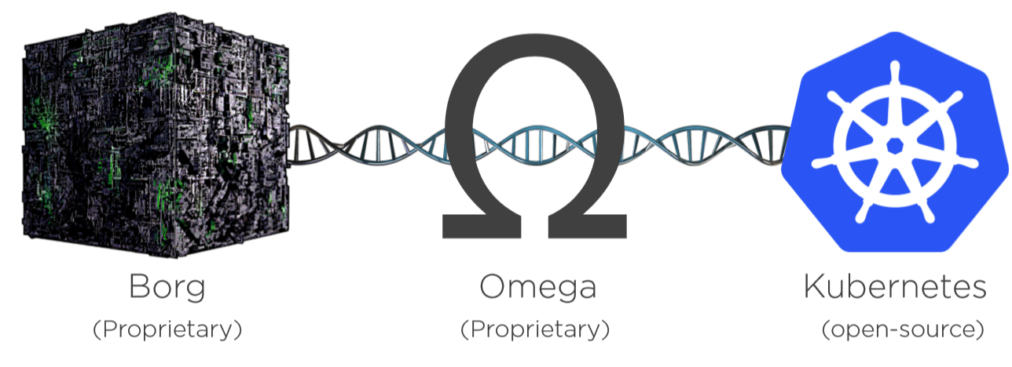
History
To SME: Need a title.
Cloud: Kubernetes

Slide 9
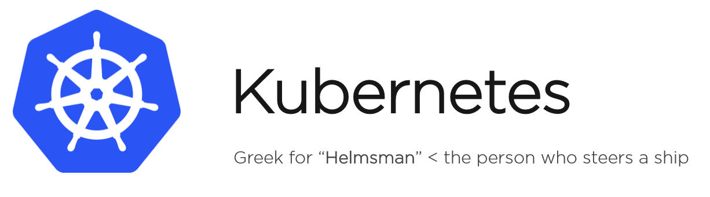
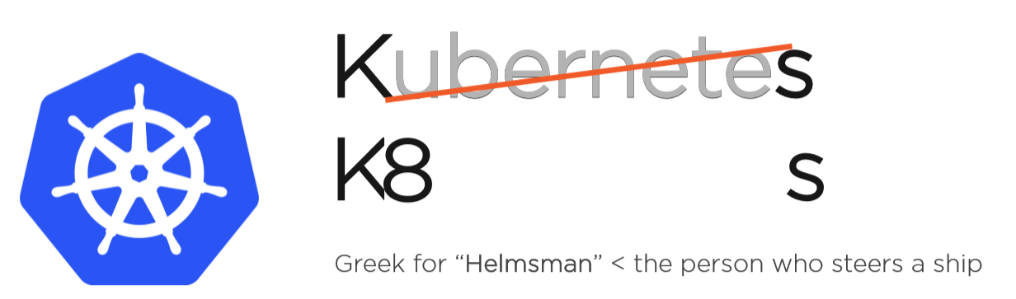
History
To SME: Need a title.
Cloud: Kubernetes

Slide 10
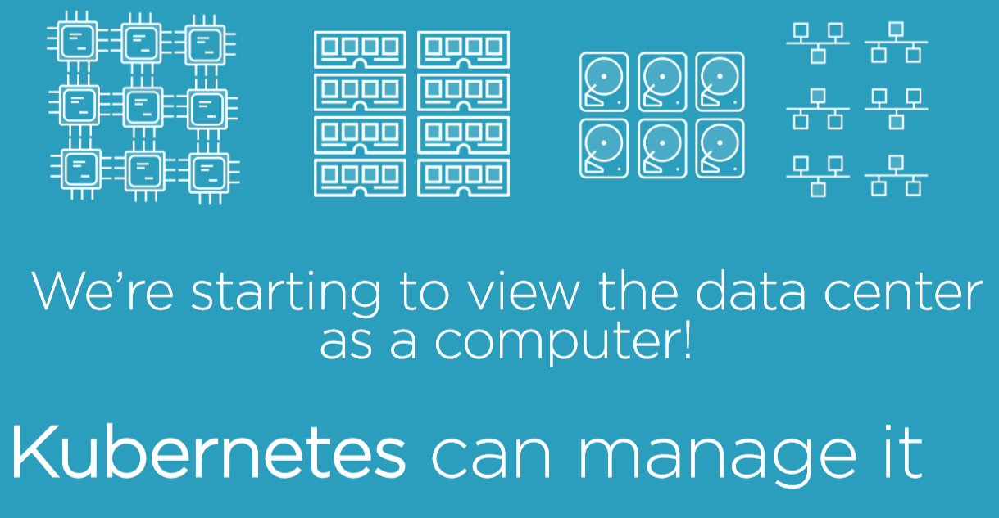
Containers bring scalability challenges!
Cloud: Kubernetes

Slide 11
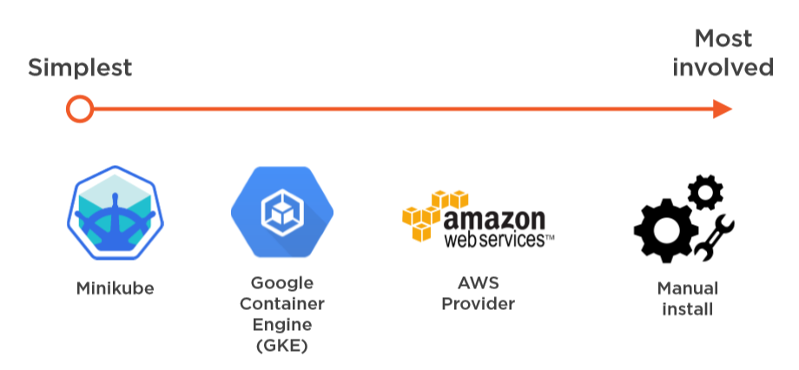
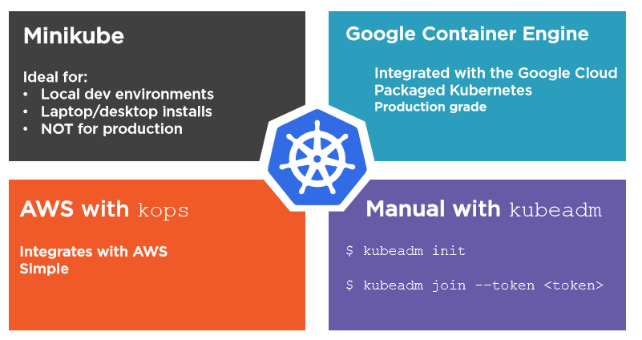
Deployment Model
Cloud: Kubernetes

Slide 12
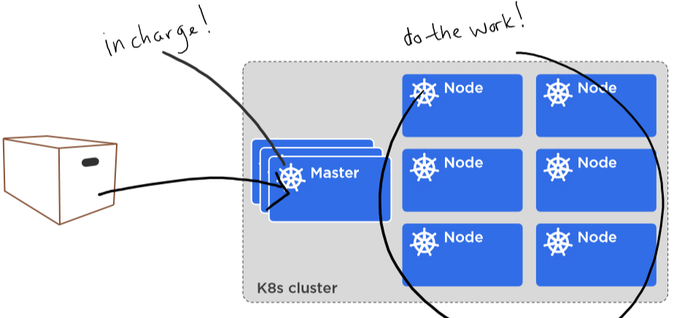
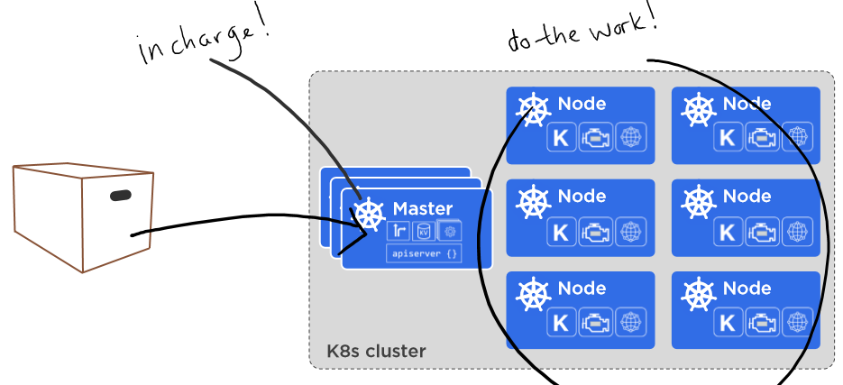
Details
Cloud: Kubernetes

Slide 13
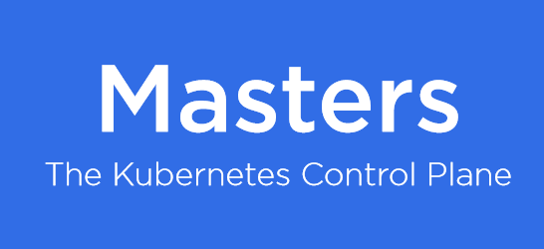
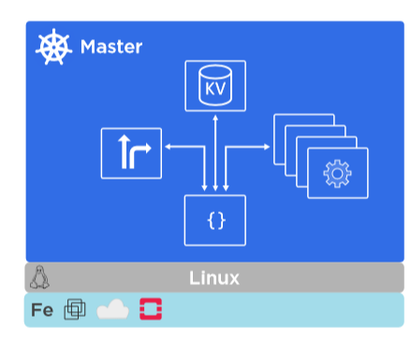
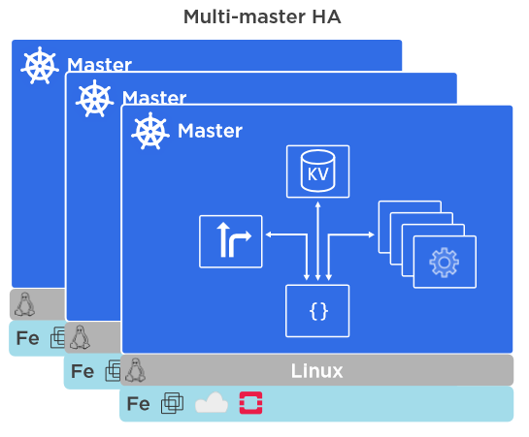
Details
Cloud: Kubernetes

Slide 14
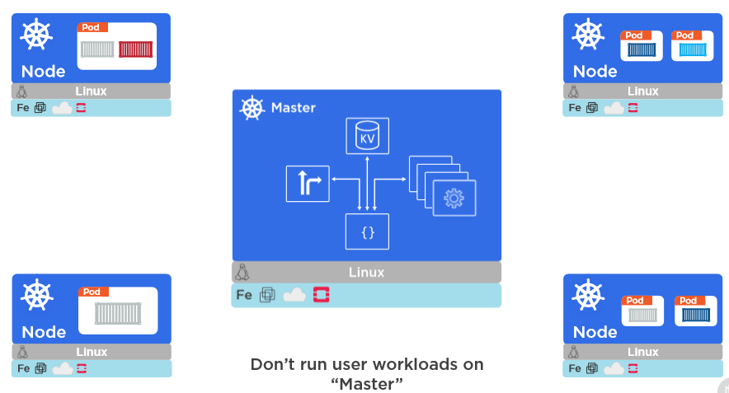
Details
Cloud: Kubernetes

Slide 15
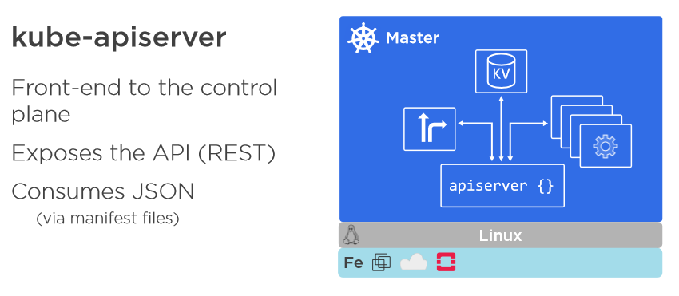
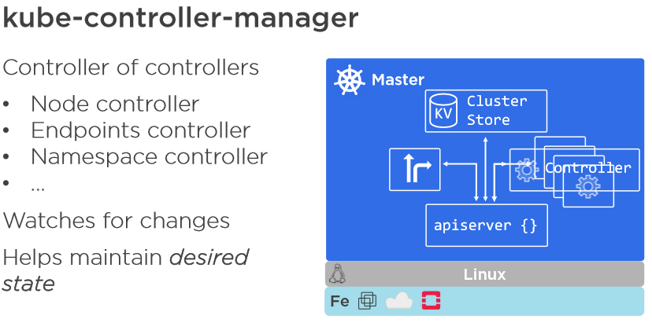
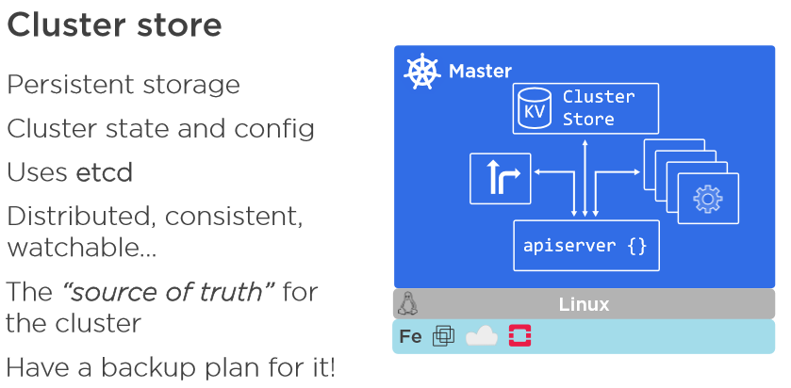
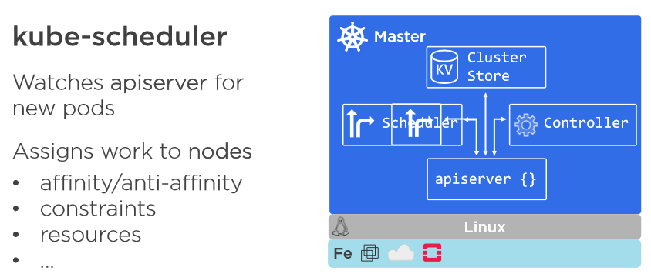
Details
Cloud: Kubernetes

Slide 16
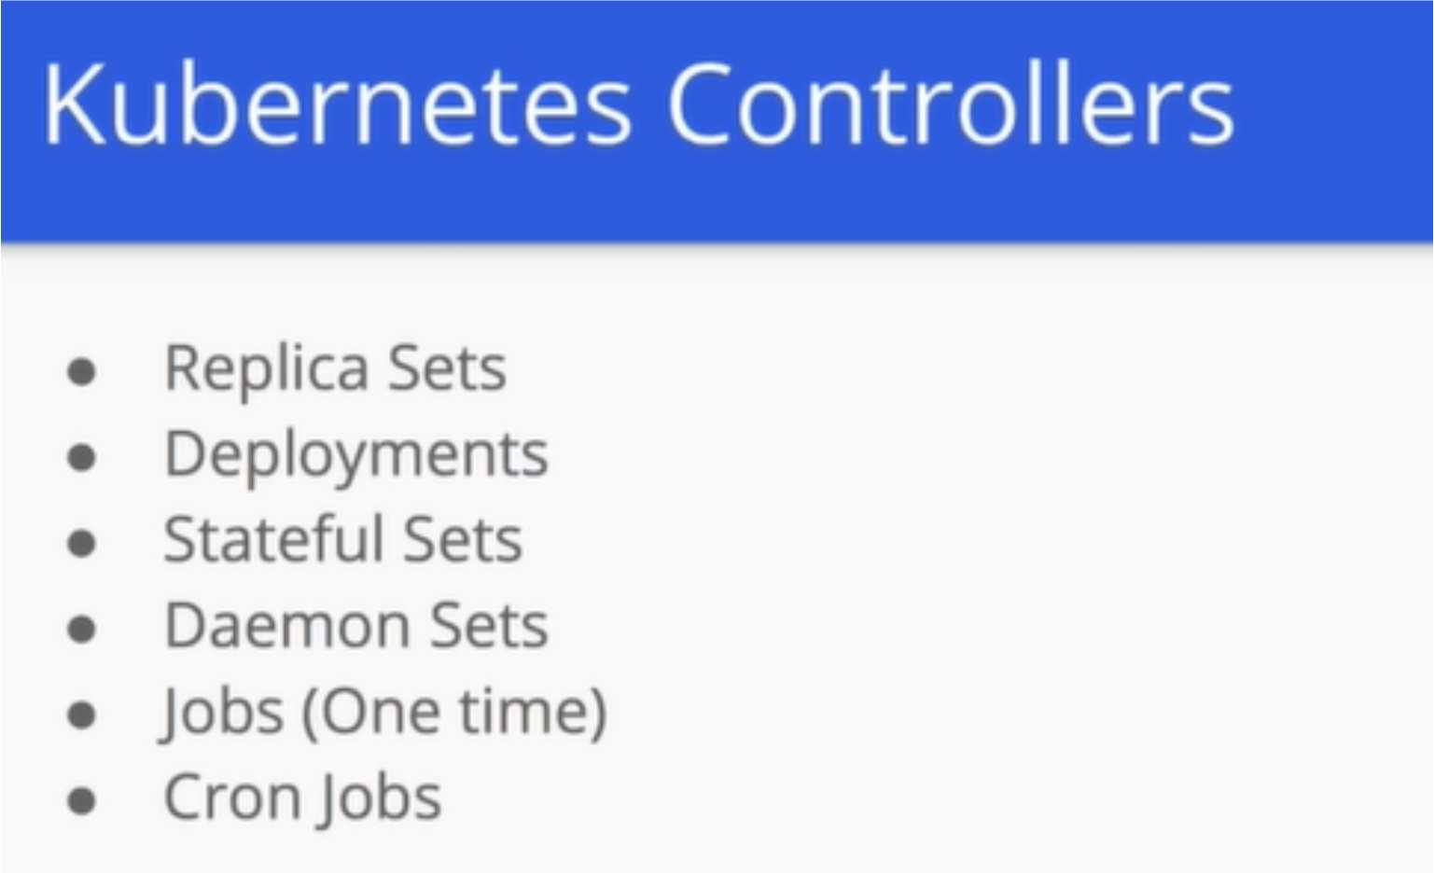
Details
Cloud: Kubernetes
To SME: Little more details on the content would make sense.

Slide 17
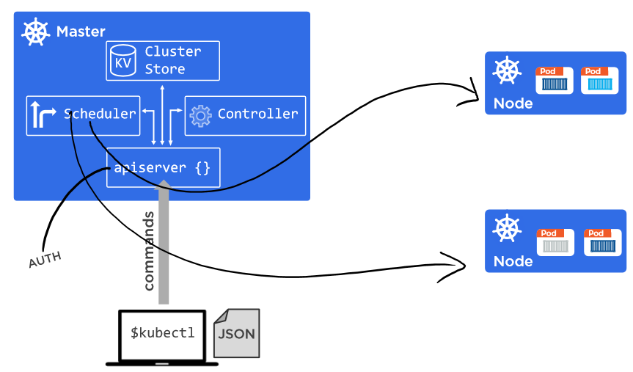
Details
Cloud: Kubernetes
To SME: Little more details on the content would make sense.

Slide 18
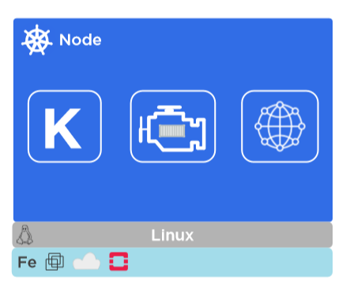
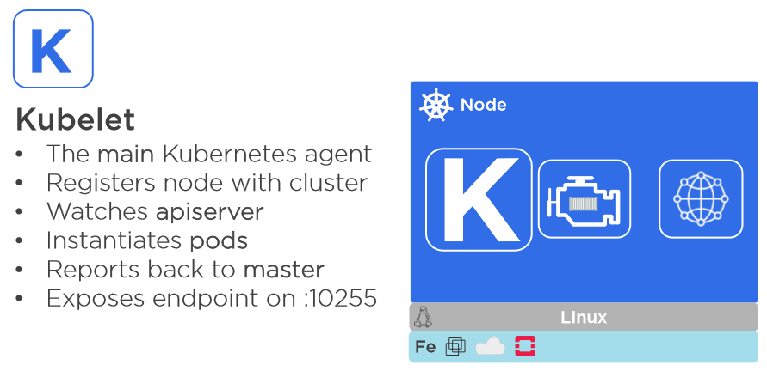
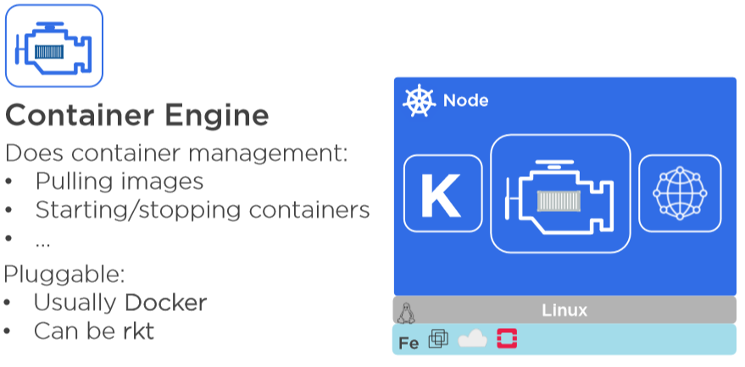
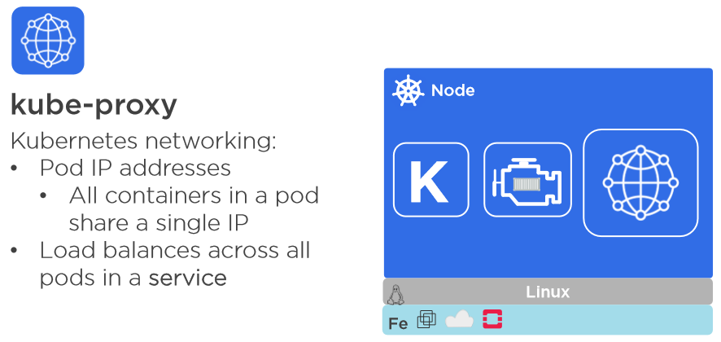
Details
Cloud: Kubernetes
To SME: Little more details on the content would make sense.

Slide 19
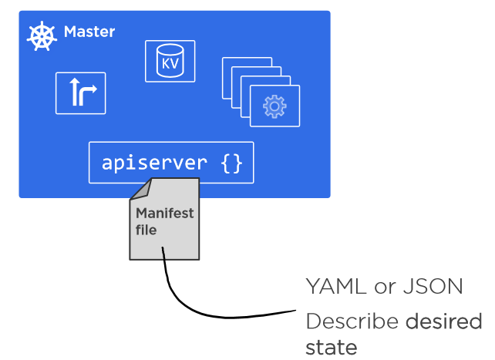
Declarative Model and Desired State
Cloud: Kubernetes
To SME: Little more details on the content would make sense.

Slide 20
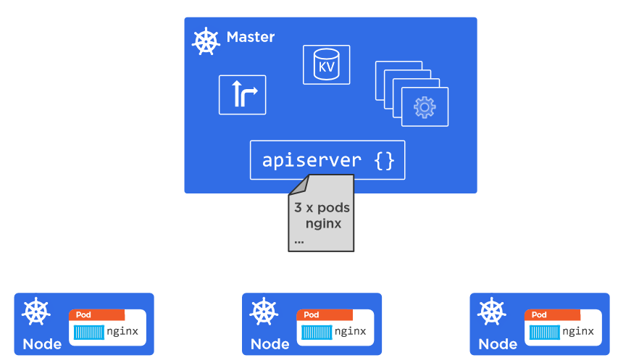
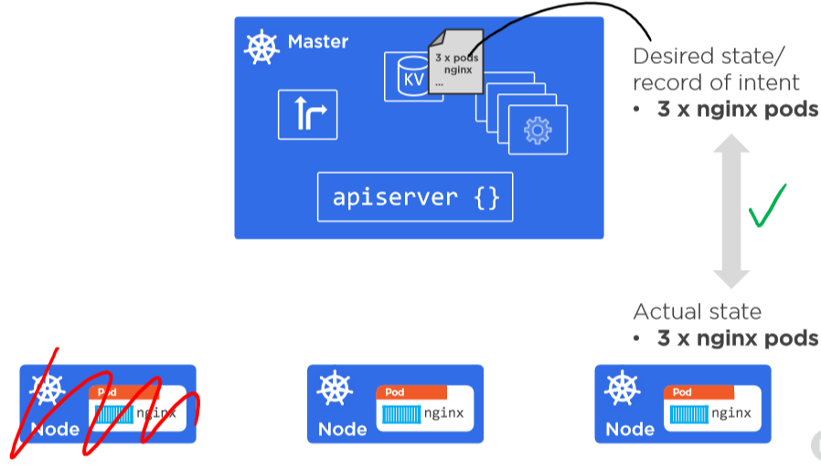
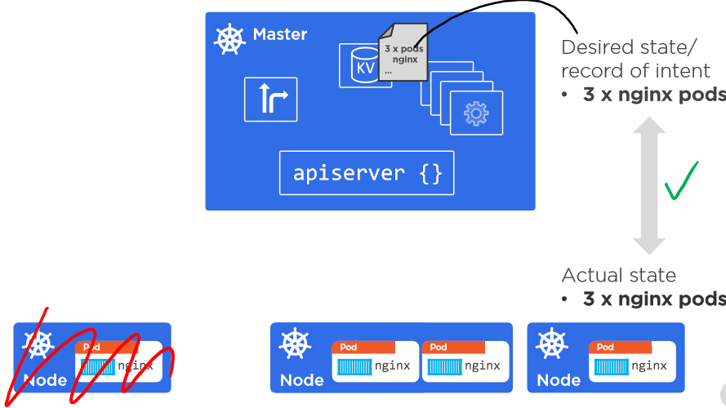
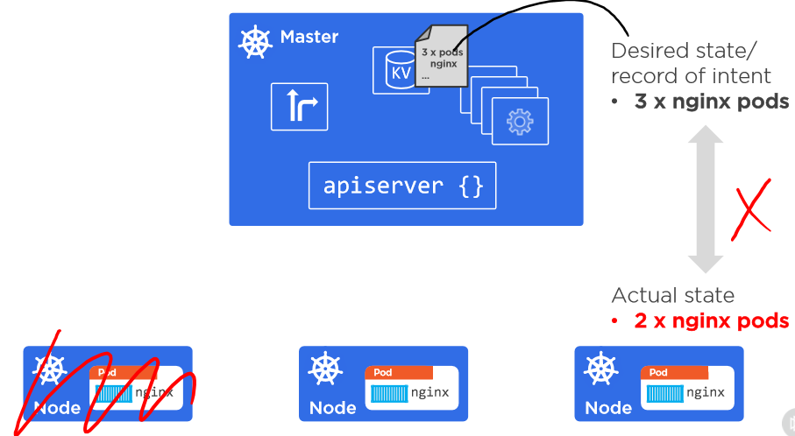
Details
Cloud: Kubernetes
To SME: Little more details on the content would make sense.

Slide 21
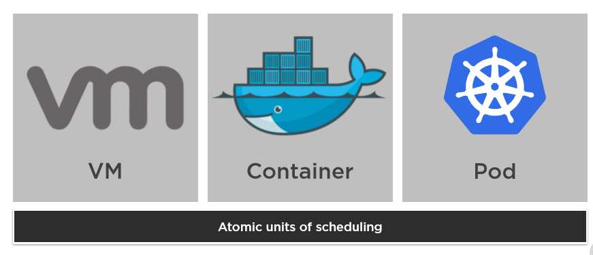
Working with Pods
Cloud: Kubernetes
To SME: Little more details on the content would make sense.

Slide 22
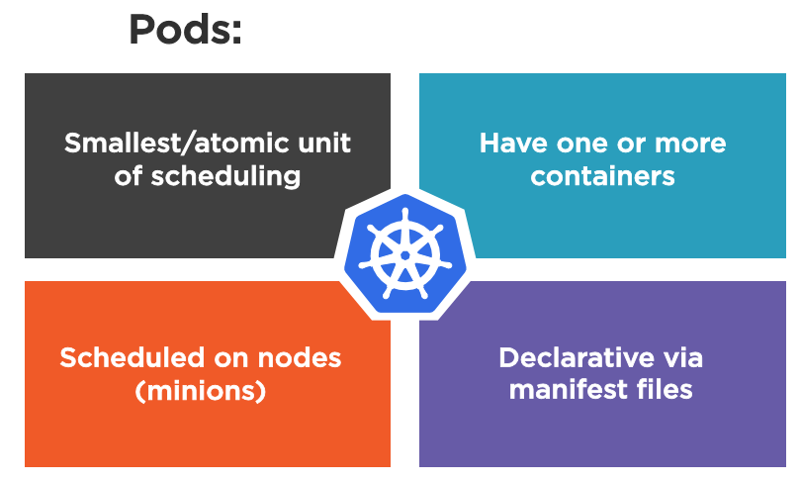
Working with Pods (continued)
Cloud: Kubernetes
To SME: Little more details on the content would make sense.

Slide 23
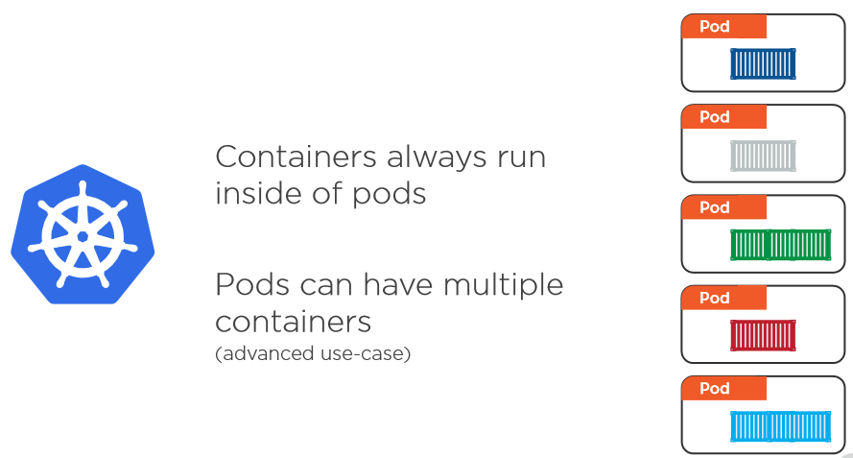
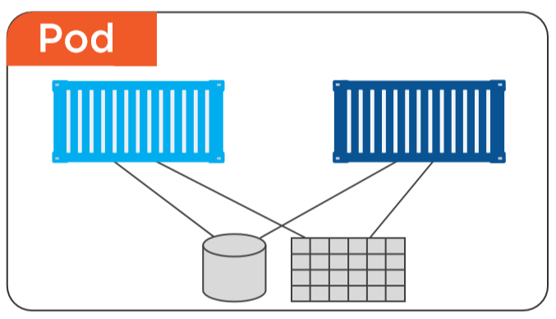
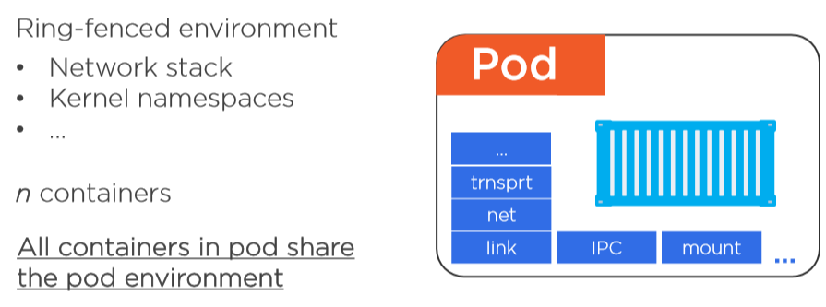
Details
Cloud: Kubernetes
To SME: Little more details on the content would make sense.

Slide 24
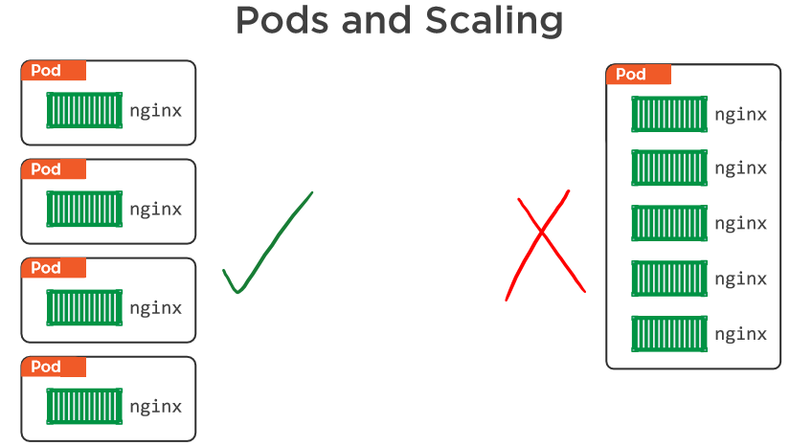
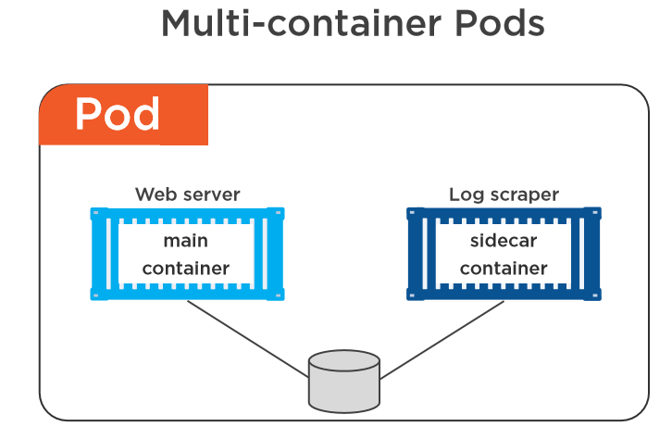
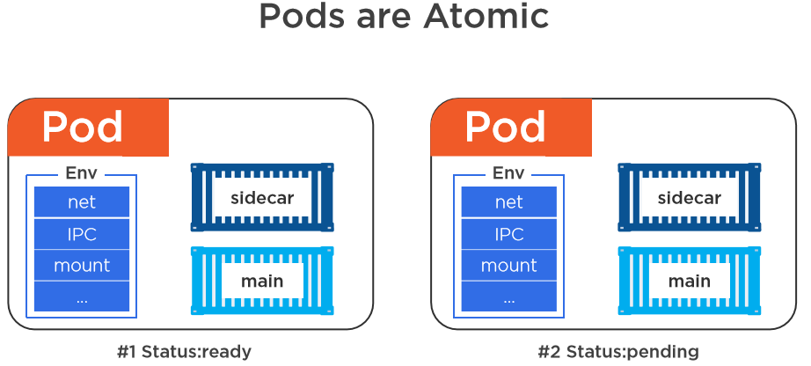
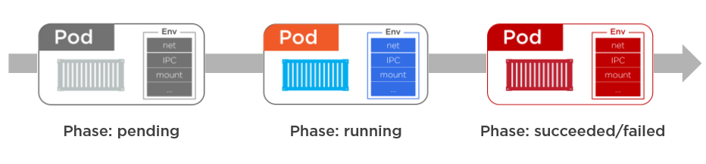
Details
Cloud: Kubernetes
To SME: Little more details on the content would make sense.

Slide 25
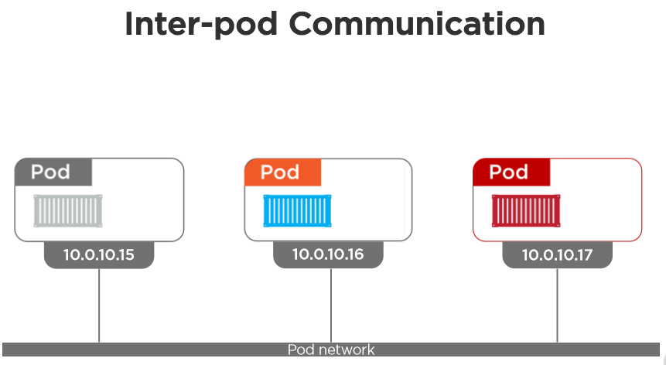
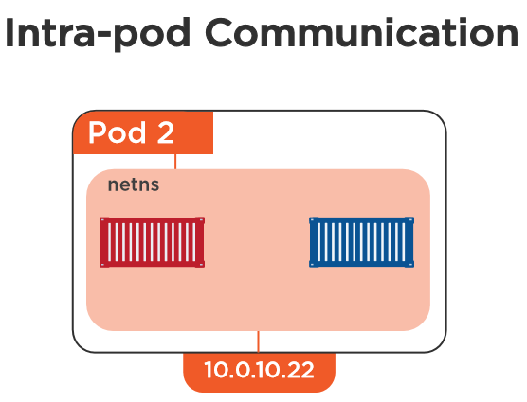
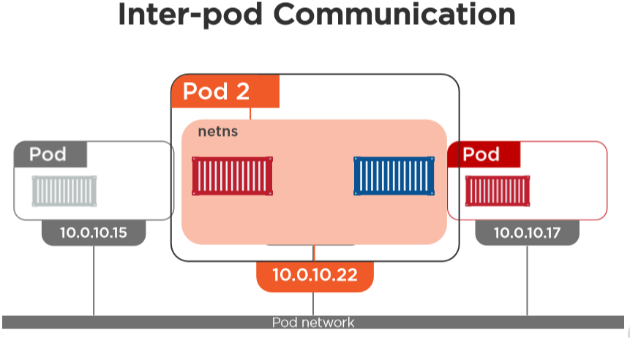
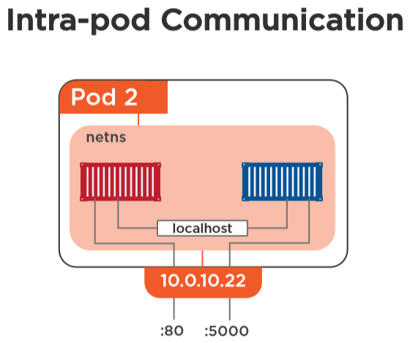
Details
Cloud: Kubernetes
To SME: Little more details on the content would make sense.

Slide 26
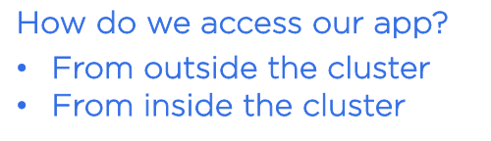
Services
Cloud: Kubernetes

Slide 27
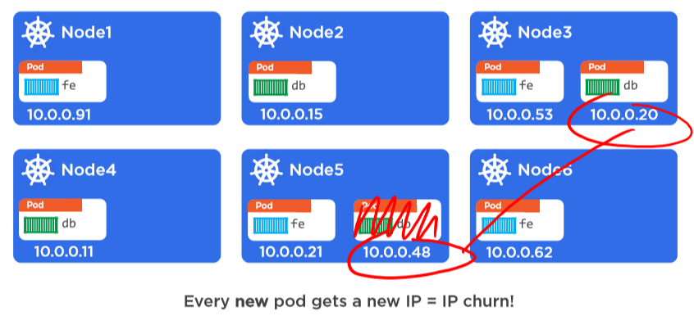
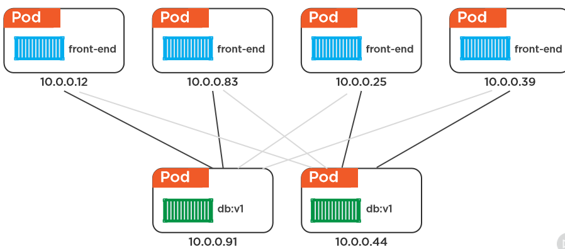
Details
Cloud: Kubernetes
To SME: Little more details on the content would make sense.

Slide 28
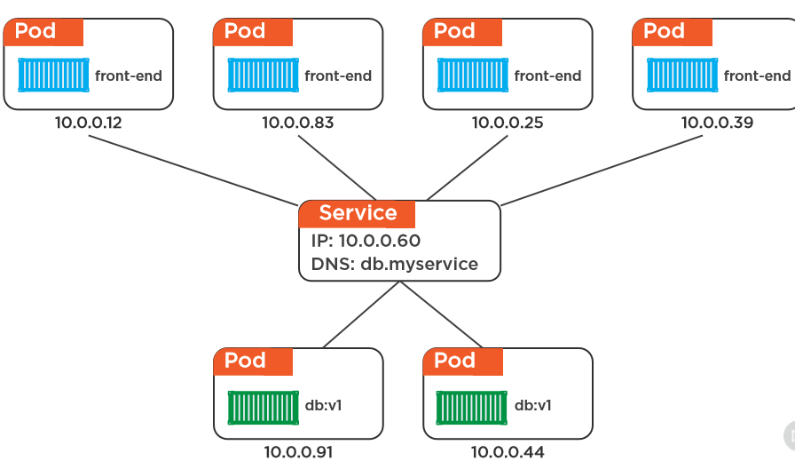
Details
Cloud: Kubernetes
To SME: Little more details on the content would make sense.

Slide 29
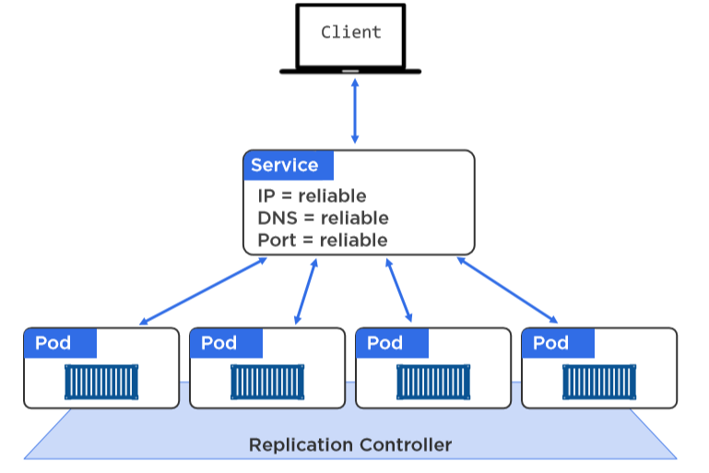
Details
Cloud: Kubernetes
To SME: Little more details on the content would make sense.

Slide 30
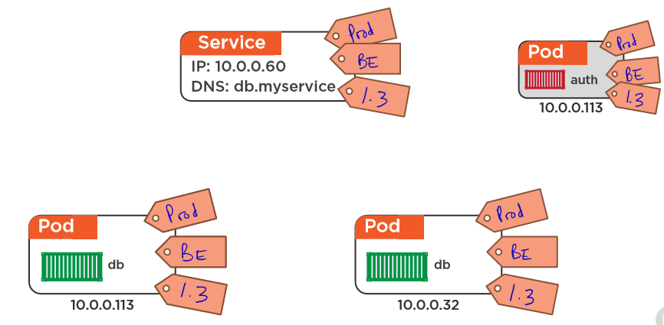
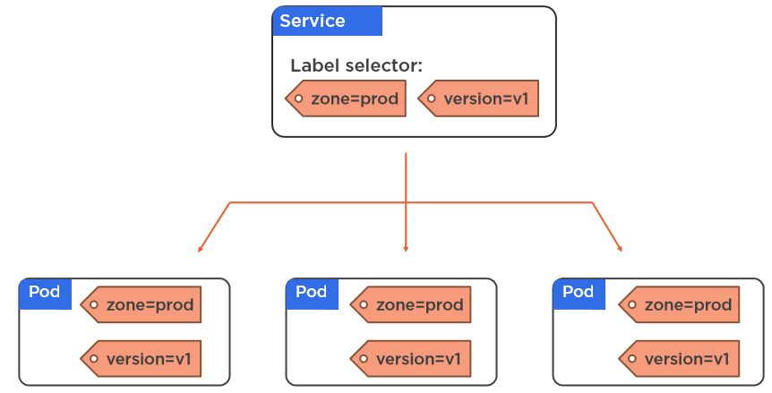
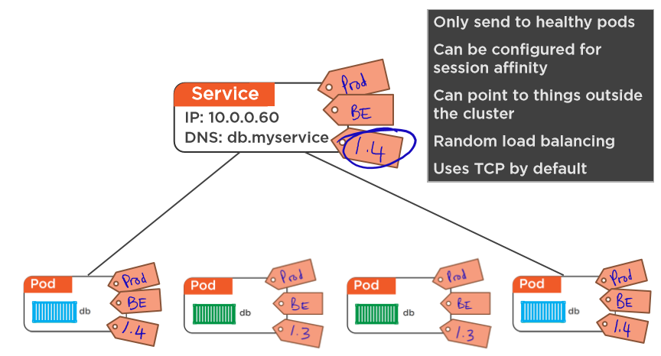
Details
Cloud: Kubernetes
To SME: Little more details on the content would make sense.

Slide 31
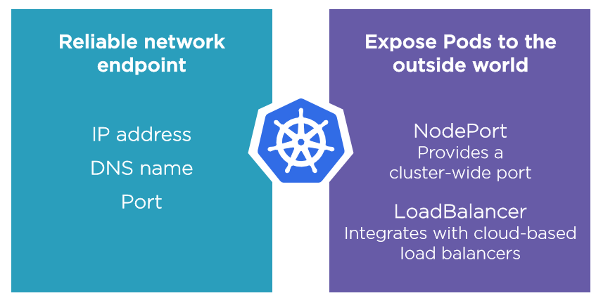
Details
Cloud: Kubernetes
To SME: Little more details on the content would make sense.

Slide 32

Deployments
Cloud: Kubernetes

Slide 33

Details
Cloud: Kubernetes
To SME: Little more details on the content would make sense.

Slide 34


Details
Cloud: Kubernetes
To SME: Little more details on the content would make sense.

Slide 35

Objects
Cloud: Kubernetes
To SME: Little more details on the content would make sense.

Slide 36

kubectl
Cloud: Kubernetes
To SME: Little more details on the content would make sense.

Slide 37






RBAC
Cloud: Kubernetes
To SME: Little more details on the content would make sense.

Slide 38

Pets versus Cattle
Cloud: Kubernetes

Slide 39

Q&A

Slide 40

Summary
Spring Cloud: API Gateway – Cloud Gateway
Summary
In this course, you learned about the following:
Kubernetes

